Slide 1
What Events Must Take Place?
Return of Jesus

Slide 2
What is happening in America?

Slide 4
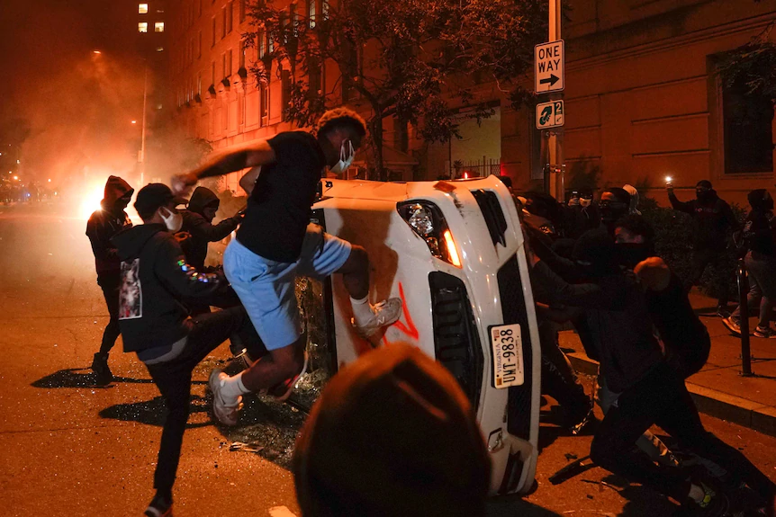

Slide 5
How can people be confused on gender?

Slide 6
Climate Change (Not global warming??)

Slide 7
Covid and 1.9 trillion

Slide 9
Global Digital Currency

Slide 10
The world is falling apart!

Slide 11
OR

Slide 12
The world is falling in place! *
*Adapted from Amir Tsarfati

Slide 13
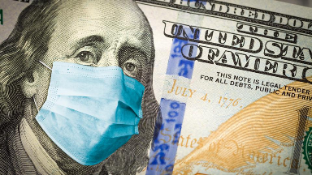
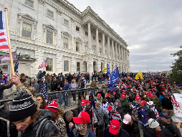
Are we seeing evidence of the return of Jesus?

Slide 14
What Events Must Take Place?
Return of Jesus

Slide 15
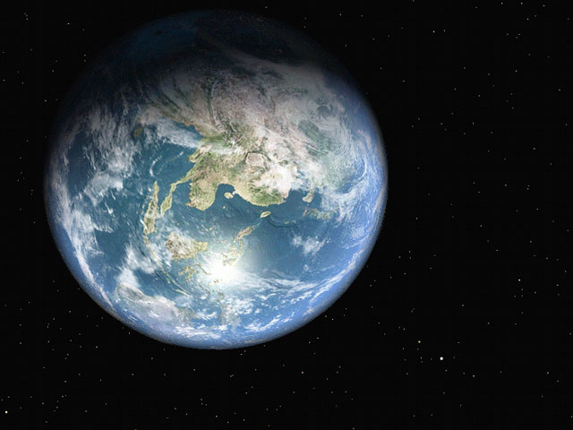
What Has Happened So Far?

Slide 16
~4500 B.C. ~3000 B.C. 2100 B.C. 1400 B.C. 1050 B.C.
Creation
Fall
Flood
Nations
Patriarchs
Exodus
Conquest
Saul,
First King of Israel

Slide 17
Pentateuch
2100 B.C. 1400 B.C. 1050 B.C.
Creation
Fall
Flood
Nations
Patriarchs
Exodus
Conquest
Saul,
First King of Israel
Genesis
Exodus
Leviticus
Numbers
Deuteronomy
Joshua
Judges
Ruth
Job?

Slide 18
1000 B.C. 600 B.C. 530 B.C. 400 B.C.
Southern Kingdom (Judah)
Northern Kingdom (Israel)
Between
the Testiments
Exile to Assyria
King Solomon
Last Prophet speaks…
Malachi
King Saul
King David
Kingdom divides
Exile to Babylon
Return from Exile

Slide 19
1000 B.C. 600 B.C. 530 B.C. 400 B.C.
Southern Kingdom (Judah)
Northern Kingdom (Israel)
Daniel
Ezekiel
Between
the Testiments
Exile to Assyria
King Solomon
Last Prophet speaks…
Malachi
King Saul
King David
Kingdom divides
Exile to Babylon
Return from Exile
Song of Songs
Psalms
Proverbs
Ecclesiastes
1 & 2 Samuel
1& 2 Kings
1 & 2 Chronicles
Ezra, Nehemiah, Esther, Malachi,
Haggai, Zechariah
Apocrypha
Amos, Hosea,
Joel, Isaiah, Micah, Zephaniah, Jeremiah, Habakkuk, Lamentations

Slide 20
1000 B.C. 600 B.C. 530 B.C. 400 B.C.
Southern Kingdom (Judah)
Northern Kingdom (Israel)
Between
the Testiments
Exile to Assyria
King Solomon
Last Prophet speaks…
Malachi
King Saul
King David
Kingdom divides
Exile to Babylon
Return from Exile
To Assyria: Jonah & Nahum
To Edom: Obadiah

Slide 21
Prophetic Timeline

Slide 22
Rewards
Rapture
Armageddon
Marriage Supper
Great White Throne Judgment
Return
Church
Age
Millennial Kingdom
1000 years
Eternal
State
Tribulation
Period
75 days of clean up
Sheep and Goat Judgment

Slide 23
What are the Signs of His Coming?
Exponential growth in travel and knowledge -Dan 12:4

Slide 24
What are the Signs of His Coming?
Daniel 12:4 “But as for you, Daniel, conceal these words and seal up the book until the end of time; many will go back and forth, and knowledge will increase.”

Slide 25
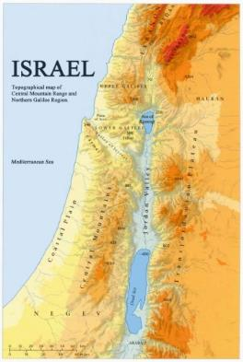
What are the Signs of His Coming?
Rebirth of Israel
May 15, 1948 On that day the nation was born

Slide 26
What are the Signs of His Coming?
Isaiah 66:8
Who has ever heard of such a thing?
Who has ever seen such things?
Can a country be born in a day
or a nation be brought forth in a moment?
Yet no sooner is Zion in labor
than she gives birth to her children.

Slide 27
What are the Signs of His Coming?
Matthew 24:32-34
“Now learn this lesson from the fig tree: As soon as its twigs get tender and its leaves come out, you know that summer is near. ³³ Even so, when you see all these things, you know that it is near, right at the door. ³⁴ I tell you the truth, this generation will certainly not pass away until all these things have happened.

Slide 28
What are the Signs of His Coming?
88 Reasons the Rapture will occur in 1988
1948 + 1 Generation
1948 + 40 years = 1988
1948 + 70 years = 2018
1948 + 80 years = 2028

Slide 29
Error?
The very next verse in Matthew:
Matthew 24:36 “No one knows about that day or hour, not even the angels in heaven, nor the Son, but only the Father.

Slide 30
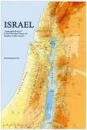
What are the Signs of His Coming?
Exponential growth in travel and knowledge
Rebirth of Israel
Re-gathering of the Jews to Israel

Slide 31
What are the Signs of His Coming?
Jeremiah 23:7-8
“So then, the days are coming,” declares the Lord, “when people will no longer say, ‘As surely as the Lord lives, who brought the Israelites up out of Egypt,’ ⁸ but they will say, ‘As surely as the Lord lives, who brought the descendants of Israel up out of the land of the north and out of all the countries where he had banished them.’ Then they will live in their own land.”

Slide 32
According to the latest figures, in 2007 Ebenezer-Operation Exodus has helped and assisted 61% of all Jewish people making aliyah from the countries of former Soviet Union where we are working. In Russia, the figure is 78% and in Central Asia this rises to 86%—in Tajikistan it is 100%.
Ebenezer has 18 bases in the former Soviet Union & 150 Volunteers and staff

Slide 33
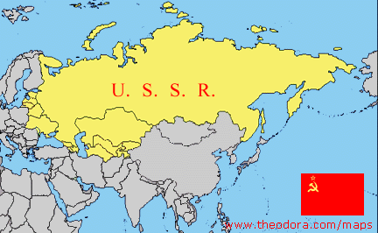
Israel will be reestablished
Until 1990- the Jews could not leave the Soviet Union

Slide 34
Israel will be reestablished
Some Christians conclude the Jeremiah verse was fulfilled with the return from Babylon…
Context :

Slide 35
Israel will be reestablished
Jeremiah 23:5-6
⁵ “The days are coming,” declares the Lord,
“when I will raise up to David a righteous Branch,
a King who will reign wisely
and do what is just and right in the land.
⁶ In his days Judah will be saved
and Israel will live in safety.
This is the name by which he will be called:
The Lord Our Righteousness.

Slide 36
Therefore:
Context of the re-gathering prophecy is the 2nd coming!

Slide 37
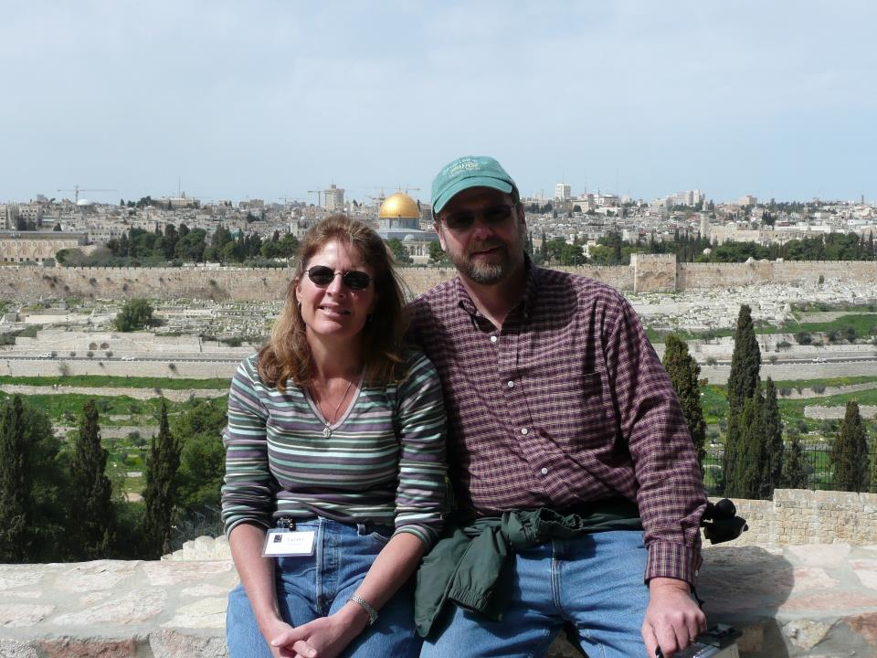
What are the Signs of His Coming?
Jerusalem no longer under Gentile rule

Slide 38
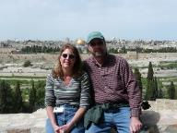
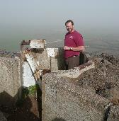
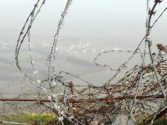
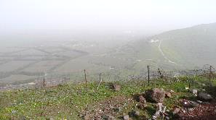
What are the Signs of His Coming?
Luke 21:24
²⁴ They will fall by the sword and will be taken as prisoners to all the nations. Jerusalem will be trampled on by the Gentiles until the times of the Gentiles are fulfilled.
6 day war (1967)delivered Jerusalem from Gentile rule… but the temple mount isn’t!

Slide 39
What are the Signs of His Coming?
Exponential growth in travel and knowledge
Rebirth of Israel
Re-gathering of the Jews to Israel
Jerusalem will no longer be under Gentile rule

Slide 40
What are the Signs of His Coming?
Increase in Deception Matt 24:4, Jer 9:5
Matthew 24:4-5
Jesus answered: “Watch out that no one deceives you. For many will come in my name, claiming, ‘I am the Christ,’ and will deceive many.

Slide 41
What are the Signs of His Coming?
Wars, famines, pestilence
Matthew 24:7-8 Nation will rise against nation, and kingdom against kingdom. There will be famines and earthquakes in various places. All these are the beginning of birth pains.

Slide 42
What are the Signs of His Coming?
Armageddon (Zech 14:12-15)

Slide 43
What are the Signs of His Coming?
Plague ends Armageddon (Zech 14:12-15)

Slide 44
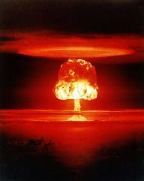
What are the Signs of His Coming?
Zechariah 14:12-15 This is the plague with which the Lord will strike all the nations that fought against Jerusalem: Their flesh will rot while they are still standing on their feet, their eyes will rot in their sockets, and their tongues will rot in their mouths.

Slide 45
What are the Signs of His Coming?
On that day men will be stricken by the Lord with great panic. Each man will seize the hand of another, and they will attack each other. Judah too will fight at Jerusalem.

Slide 46
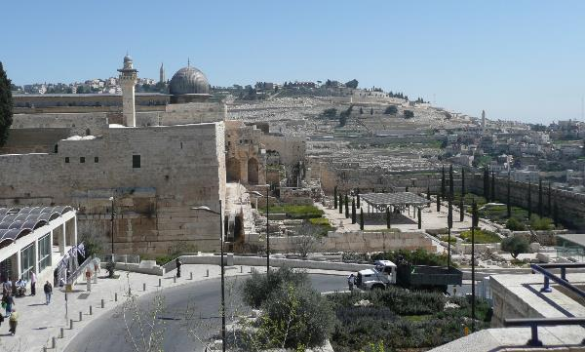
What are the Signs of His Coming?
Context: Jesus returns and splits the Mount of Olives

Slide 47
What are the Signs of His Coming?
Mark of the Beast
Absolute control on all financial transactions

Slide 48
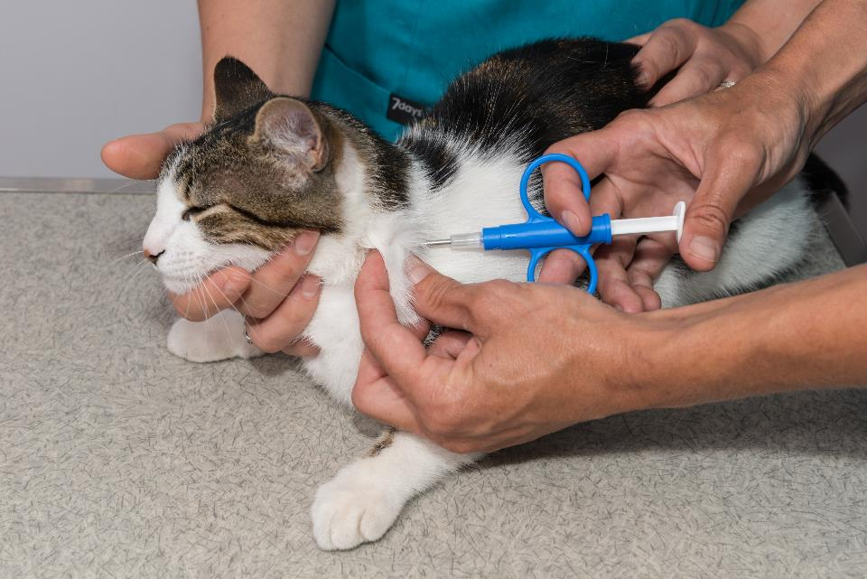

Slide 49
Sweden

Slide 50
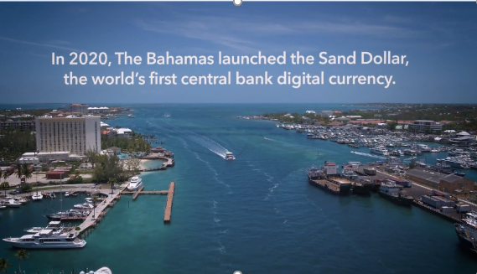
Bahamas

Slide 51
Revelation 13:16–18 (ESV)
16 Also it causes all, both small and great, both rich and poor, both free and slave, to be marked on the right hand or the forehead,
17 so that no one can buy or sell unless he has the mark, that is, the name of the beast or the number of its name.
18 This calls for wisdom: let the one who has understanding calculate the number of the beast, for it is the number of a man, and his number is 666.

Slide 52
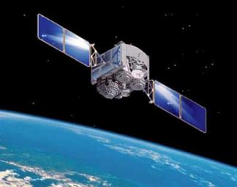
What are the Signs of His Coming?
Global eye in the sky Rev 11:9-12

Slide 53
What are the Signs of His Coming?
Revelation 11:9-12 For three and a half days men from every people, tribe, language and nation will gaze on their bodies and refuse them burial. The inhabitants of the earth will gloat over them and will celebrate by sending each other gifts, because these two prophets had tormented those who live on the earth

Slide 54
What are the Signs of His Coming?
Global eye in the sky Rev 11:9-12
How can all the people of the nations see this?
Satellite transmission
Internet transmission
NOTE: This is something that is certainly true only of these last years!

Slide 55
What are the Signs of His Coming?
Earth quakes Matt 24:7

Slide 56
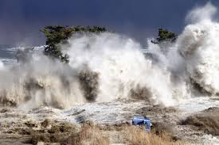
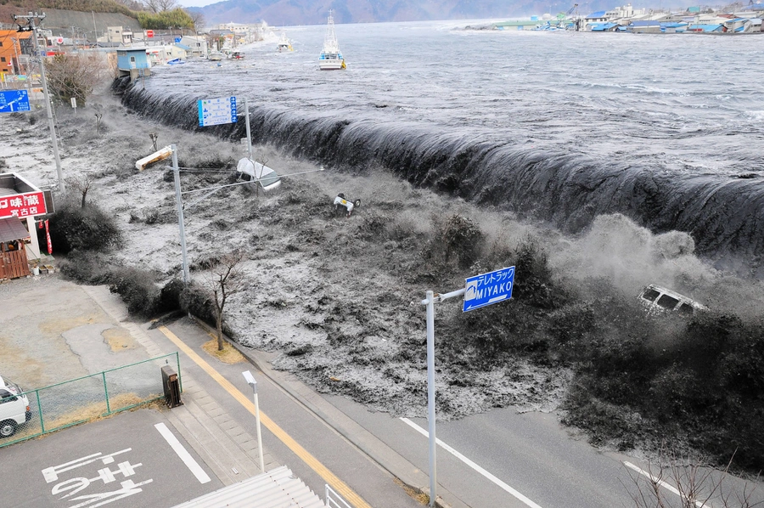
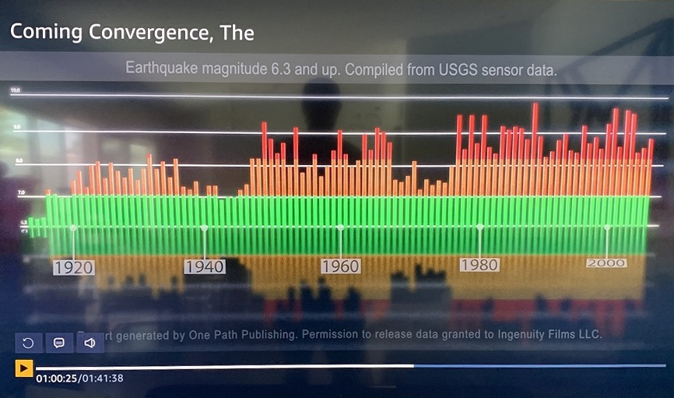
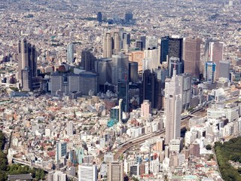
Strong Earthquake Shakes Tokyo Area; No Reports of Casualties or Damage TOKYO August 9, 2009 (AP)
Report: USGS Data Shows Earthquakes Increasing In Magnitude & Frequency
July 23, 2020Pattern Is Prologue

Slide 57
What are the Signs of His Coming?
Earth quakes Matt 24:7
20th century is known as the century of earthquakes.
We have records from the 13th century
If you put all the earthquakes from the 13th to the 19th they are still less than what took place in the 20th century

Slide 58
What are the Signs of His Coming?
As in the days of Noah (Matt 24:36-39)

Slide 59
What are the Signs of His Coming?
Matthew 24:36-39 “No one knows about that day or hour…
As it was in the days of Noah, so it will be at the coming of the Son of Man.

Slide 60
What are the Signs of His Coming?
For in the days before the flood, people were eating and drinking, marrying and giving in marriage, up to the day Noah entered the ark; and they knew nothing about what would happen until the flood came and took them all away. That is how it will be at the coming of the Son of Man.

Slide 61
What are the Signs of His Coming?
As in the days of Noah (Matt 24:36-39)
Insensitivity to the things of the Lord
Scoff at the coming of the Lord
THEREFORE they believe that life will just go on and on without any God Who has a program
= Naturalistic view of Life!

Slide 63
Are we close?
What do you think?

Slide 64
Rewards
Rapture
Armageddon
Marriage Supper
Great White Throne Judgment
Return
Church
Age
Millennial Kingdom
1000 years
Eternal
State
Tribulation
Period
75 days of clean up
Sheep and Goat Judgment

Slide 65
Matthew 24:32-33 “Now learn this lesson from the fig tree: As soon as its twigs get tender and its leaves come out, you know that summer is near. Even so, when you see all these things, you know that it is near, right at the door.

